Slide 1
2021 Non Destructive Technology Apprenticeships
2021 Condition Monitoring Conference
Dr Iain Baillie, Chief of Resource Strategy Rolls-Royce & President BINDT
June 2021
This information is provided by Rolls-Royce in good faith based upon the latest information available to it; no warranty or representation is given; no contractual or other binding commitment is implied.
Non-confidential
© 2021 Rolls-Royce
Not Subject to Export

Slide 2
Contents
Introduction
The problem with NDT recruitment
Government trailblazers (England and Scotland)
Rolls-Royce requirements
Costs
Project examples
Non-confidential
© 2021 Rolls-Royce
Not Subject to Export

Slide 3
01
Introduction
Non-confidential
© 2021 Rolls-Royce
Not Subject to Export

Slide 4
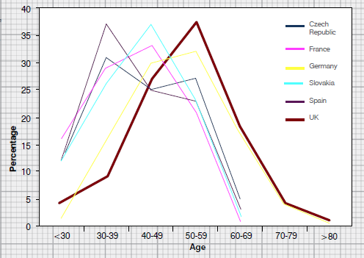
Problem Statement
01
REF: KTN Report “A Landscape for the future of NDT in the UK Economy”
Our UK ~450 NDT suppliers to Rolls-Royce are in the same boat…………
Big change - average age of PCN certificate holder = 40
Non-confidential
© 2021 Rolls-Royce
Not Subject to Export

Slide 5
02
Solution
Non-confidential
© 2021 Rolls-Royce
Not Subject to Export

Slide 6
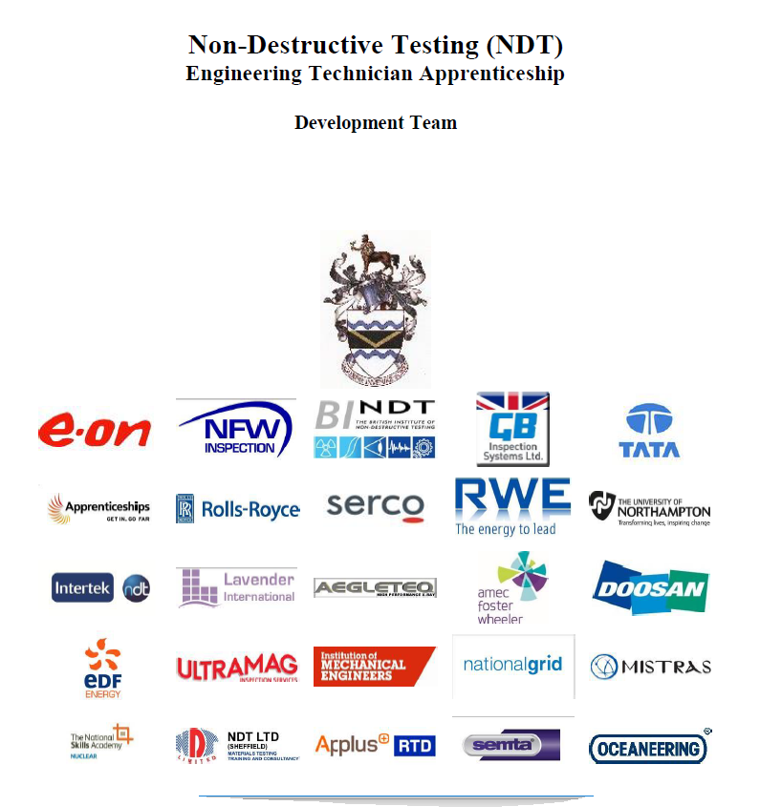
02
An opportunity for England
BINDT became aware the Government were looking at new “Trailblazer” apprenticeships.
BINDT formed an employer’s group to help draft new Government standards.
Rolls-Royce took on the role
of “lead employer.”
Project Managed BINDT’s
& Roger Lyon.
Non-confidential
© 2021 Rolls-Royce
Not Subject to Export
Non-confidential
© 2018 Rolls-Royce
Not Subject to Export Control

Slide 7
02
What the employer group wanted
NDT qualifications (EN4179 and/or PCN ISO:9712).
Flexibility to chose what (or even if) we wanted when it came to college & university courses.
To ensure apprentices were ethical and had the right work behaviours; communication, project delivery, integrity,
To be as inclusive as possible, so small and large employers could use the scheme. To ensure equipment manufacturers could use the scheme.
To ensure we gained the maximum possible funding
To cover shop floor inspectors at NDT Level 2 and promoting them to the next NDT Level 3.
Non-confidential
© 2021 Rolls-Royce
Not Subject to Export
Non-confidential
© 2018 Rolls-Royce
Not Subject to Export Control

Slide 8
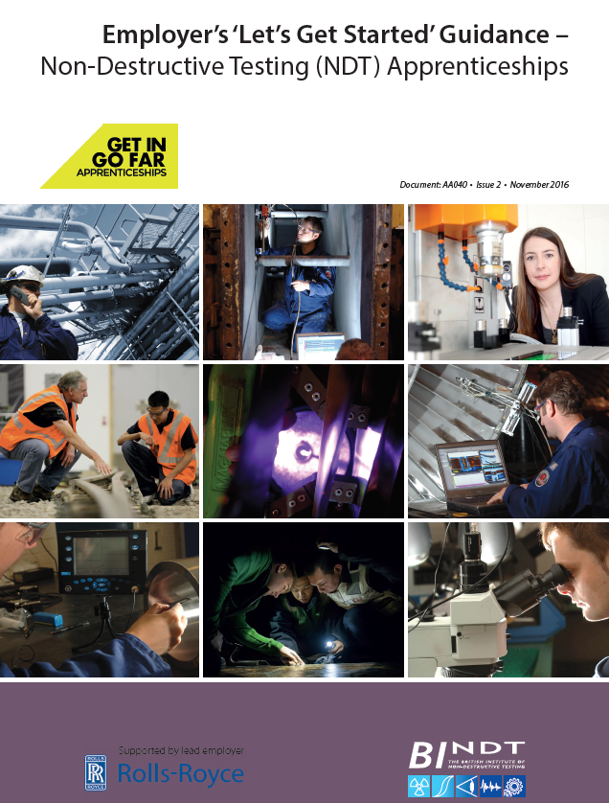
03
How to get started/what to do (England)
Find a “Lead Provider.” They are the ones who work with the employer to create a programme. Consult BINDT if stuck.
The employer selects what NDT methods and training is required. They have the choice of which NDT Training School to use for PCN/EN4179.
Ensure you read the BINDT checklists on how to run the programme (e.g. quarterly reviews, evidence, NDT experience log book etc).
Assign the Apprentice a suitable project(s)
Complete the “portfolio of evidence”
Prepare the Apprentice for their “End point assessment”
Non-confidential
© 2021 Rolls-Royce
Not Subject to Export
Non-confidential
© 2018 Rolls-Royce
Not Subject to Export Control

Slide 9
 |  | Apprenticeship Certificate Requirements (Government Standard & Mandatory) |  |  | Engineering Council Requirements, administered by the British Institute of NDT (BINDT)
Country | Standard | Max. Funding | Approx. Time Taken | Qualifications (Mandatory) | No. of years engineering experience | BINDT membership and Engineering Registration suitability
England | Operator STO358 | £12K | 1.5 years | 1 NDT Level 2 | EngTech – 3 years’ experience | AMInstNDT (with 3 years experience)
 | Technician STO2888 | £18K | 3 years | 3 NDT Level 2s | IEng – 5 years’ experience | AMInstNDT (with 3 years experience)
 | Engineer STO369 | £27k | 4 years | >= 1 NDT Level 3 BEng or BSc NDT Degree | Interim IEng after 4 years experience with 1 year wait for full registration. | MInstNDT (with 5 years experience)
Scotland | Technician (Draft) |  | 3 years | NDT Level 2s + college qualification (draft) |  | AMInstNDT (with 3 years experience)
 | Graduate Apprenticeship Engineering | University fees = £0 | 4 years | BEng (Hons) Engineering: Design and Manufacture | IEng – 5 years’ experience | MInstNDT (with 5 years experience)
ibaillie2017

Slide 10
03
Apprentice Numbers
Current apprentices | Qualifications | Numbers
Operator | 1 Level 2 | 27
Technican | 3 Level 2s | 96
Engineer | Level 3s + Degree | 28
Apprentices who have now passed EPAs | Qualifications | Numbers
Operator | 1 Level 2 | 2
Technician | 3 Level 2s | 12
Engineer/Graduate | Level 3s + Degree | 1
Non-confidential
© 2021 Rolls-Royce
Not Subject to Export

Slide 11
04
Condition Monitoring

Slide 12
04
Condition Monitoring – Reviewed by BINDT’s Condition Monitoring Technical Committee
Non Destructive Technology Apprentices
Operator
(1 NDT Method)
Technician
(3 NDT Methods)
Engineer
(Degree Level) + NDT L3
Being reviewed 2nd
ETA Jan 2022
Just needs more CM methods listed and to delete the NDT (where T = Testing)
Skills, Behaviours and Knowledge the same
Already available for CM & SHM use
Needs reviewed in 2022.
?
?
✓
BINDT can talk to the Institute for Apprentices for guidance if needed ASAP.
Non-confidential
© 2021 Rolls-Royce
Not Subject to Export
Non-confidential
© 2018 Rolls-Royce
Not Subject to Export Control

Slide 13
05
Conclusion
CM easy to incorporate. Good support from Institute of Apprentices.
During the apprenticeship, they start to become VERY useful after a year or so.
Excellent work ethic and enthusiasm
Prize winning (e.g. top of year 1st class degrees, university prizes, BINDT prizes, IOM³ awards etc)
Right thing to do
We need to remove the barriers between NDT, CM and SHM
Non-confidential
© 2021 Rolls-Royce
Not Subject to Export

